Slide 1
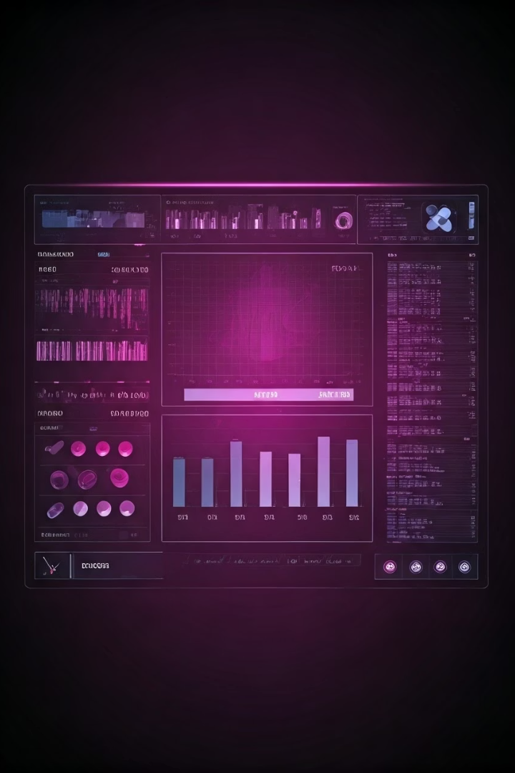
MediTrack: Revolutionizing Chronic Disease Management
MediTrack offers efficient drug prescription management. It is tailored for chronic disease patients. The software optimizes health outcomes and communication.
Developer: Makala Smith, Alexis Francis
Original Developer: Mohamed Riyaz Khan

Slide 2
The Challenge: Chronic Disease Medication Management
Complexity
Adverse Interactions
Adherence
Managing multiple medications can be complex.
There is a high risk of adverse drug interactions.
Adherence challenges and compliance issues exist.
Real-time monitoring and communication are lacking.

Slide 3

Introducing MediTrack: A Comprehensive Solution
Advanced Tracking
Personalized Schedules
Efficient drug prescription management with tracking.
Personalized dosage schedules and refill alerts provided.
Integrated Monitoring
Integrated side effect monitoring and reporting available.
Streamlined communication between patients and providers.

Slide 4
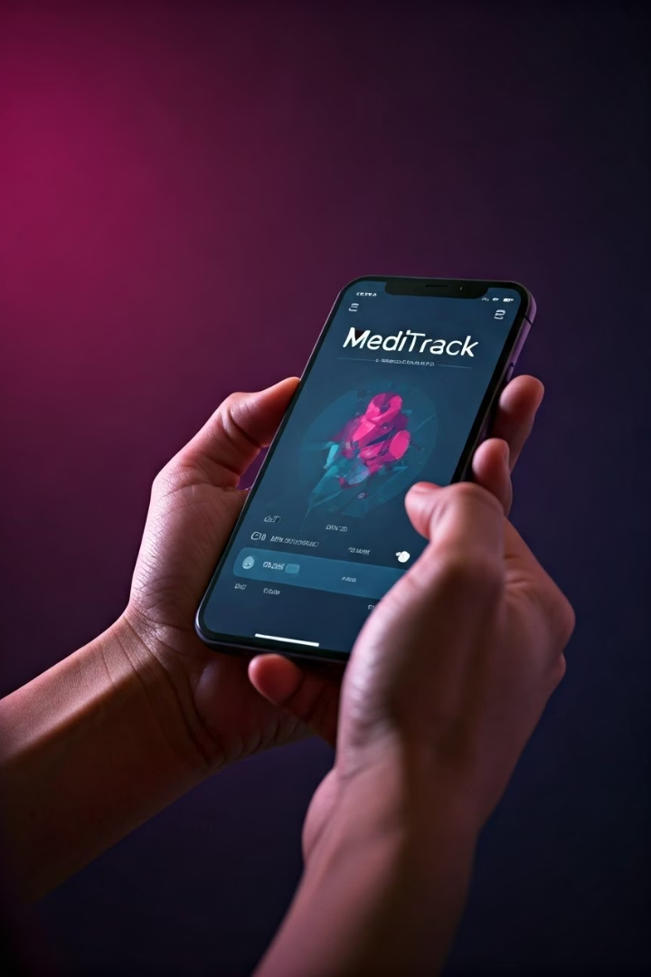



Key Features: Empowering Patients
Mobile Access
Adherence Tracking
Education
The platform includes secure data storage and privacy protection.

Slide 5




Benefits for Healthcare Providers
Real-time data
Access real-time patient data and insights.
Improved adherence
Achieve better medication adherence and patient outcomes.
Reduced errors
Reduce administrative burden and errors.
Enhanced communication and collaboration are enabled.

Slide 6



Real-World Impact: Case Studies
Improved Adherence
1
40% increase
Reduced Readmissions
2
25% reduction
Patient Satisfaction
3
Quality of life
Specific examples of successful chronic disease management.

Slide 7
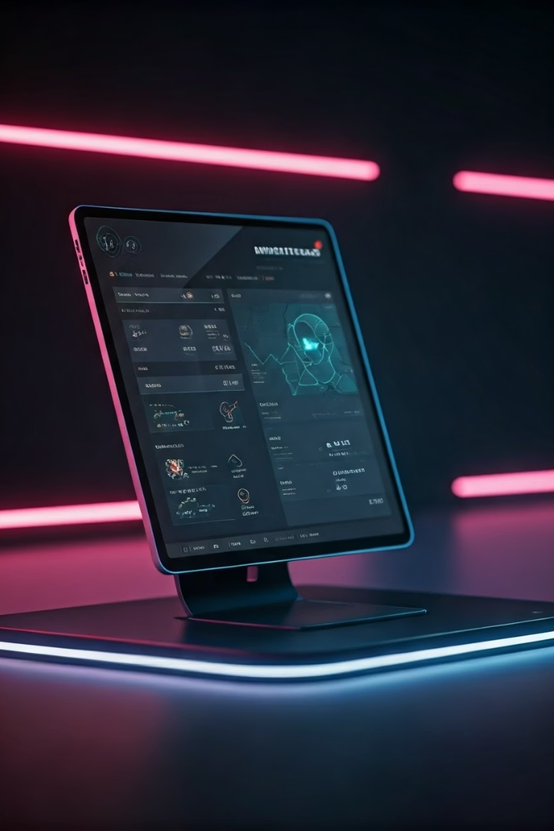
The Future of MediTrack: Innovations and Expansion
Wearable Integration
Continuous monitoring.
AI-Powered
Personalized recommendations.
Expansion
New chronic disease areas.
Partnerships with leading healthcare organizations.

Slide 8

MediTrack: Improving Lives
Optimal Health
Seamless Communication
Optimal outcomes for chronic disease patients.
Between patients and providers.
Start Improving
Contact us for a demo.

